Slide 1


Olist Store Analysis
Presented By:: Group # 6

Slide 2
Index
Introduction
Data Overview
Objectives : KPI’s
Analysis
Recommendations and Insights
Conclusions

Slide 3

Introduction

Slide 4
Purpose of the Analysis:
The goal of your project—analyzing the e-commerce company’s data to gain insights into business performance, customer preferences, and operational efficiencies.
that this analysis aims to help the company better understand its strengths and challenges, enabling data-backed decisions to improve customer experience, optimize processes, and drive growth.
Tools and Methodology:
Excel
Tableau & Sql
Power BI

Slide 5

Data Overview
Data Analysis and Review

Slide 6
Data Overview
Comprehensive Data Sources: The analysis uses nine datasets covering customers, orders, products, sellers, and payments, providing a complete view of the e-commerce operations.
Dataset Relevance: Each dataset serves a unique purpose—ranging from customer demographics to order details and product specifics—enabling in-depth insights into sales, customer satisfaction, and operational efficiency.
Holistic Integration: Integrating these datasets allows for a detailed analysis across the customer journey, supporting key performance evaluations from browsing to order fulfillment.

Slide 7
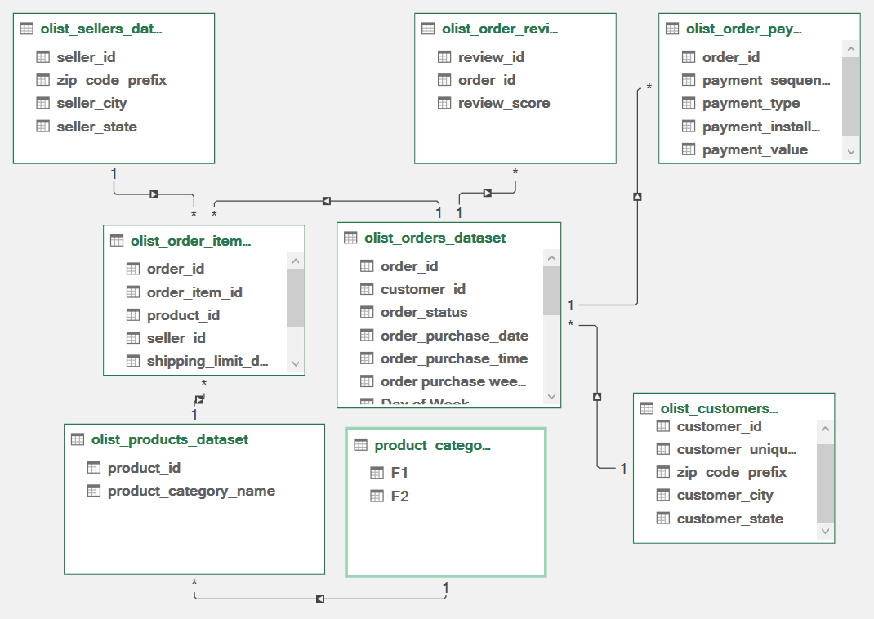
Data model:

Slide 8
Objectives : KPI’s

Slide 9

Key Performance Indicators (KPI’s):
Weekday Vs Weekend (order_purchase_timestamp) Payment Statistics
Number of Orders with review score 5 and payment type as credit card.
Average number of days taken for order_delivered_customer_date for pet_shop
Average price and payment values from customers of sao paulo city
Relationship between shipping days (order_delivered_customer_date - order_purchase_timestamp) Vs review scores.

Slide 10
Analysis

Slide 11
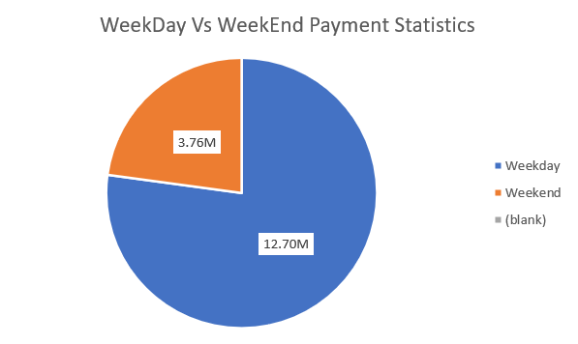
Weekday Vs Weekend Payment Statistics ​
Payment Distribution: A significant majority of payments, approximately 77%, occur on weekdays (12.7M), indicating that most transactions happen during the workweek.
Weekend Activity: Only about 23% of payments (3.76M) take place on weekends, suggesting lower customer activity or purchasing behavior over the weekend.
Insights for Strategy: This trend could imply higher engagement and sales potential on weekdays, which might inform targeted marketing or promotional strategies focused on weekday shoppers.

Slide 12
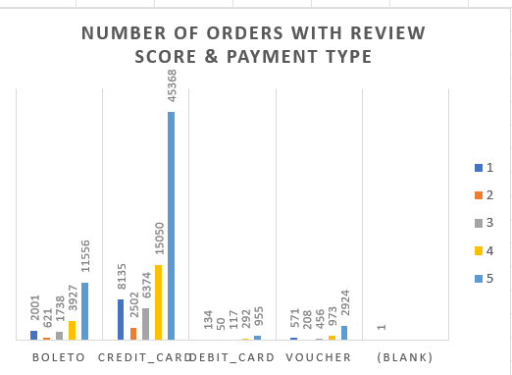
Number of Orders with review score 5 and payment type as credit card. ​
High Satisfaction with Credit Card Payments: The highest number of orders with a 5-star review score is associated with the credit card payment method, with 45,588 orders, indicating strong customer satisfaction among credit card users.
Credit Card as Preferred Payment: This high volume of positive reviews (score 5) for credit card payments suggests that credit cards are not only popular but may also correlate with a better customer experience or order success rate.
Strategic Insight: This trend can inform future strategies by reinforcing credit card payment options, possibly enhancing customer experience initiatives for these transactions, given their association with higher satisfaction levels

Slide 13
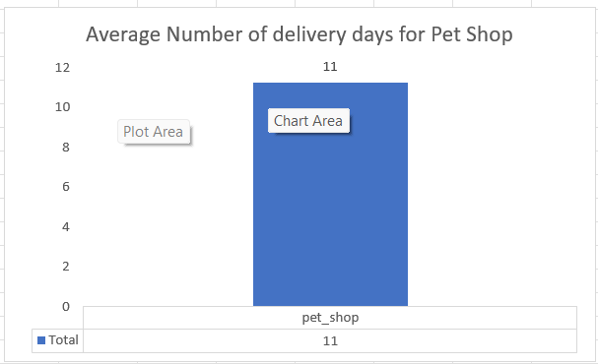
Average number of delivery days taken for pet shop ​
Delivery Performance Analysis: This KPI reflects the average time taken for orders to be delivered to customers, which is 11 days for the Pet Shop. It helps assess the efficiency of the supply chain and the timeliness of customer order fulfillment.
Customer Satisfaction Impact: A higher average delivery time may negatively influence customer satisfaction, as longer wait times can affect the overall customer experience. Reducing this average can lead to improved satisfaction and repeat business.
Operational Benchmarking: Tracking this KPI allows the Pet Shop to benchmark its performance against industry standards or competitors, identifying potential areas for process optimization to minimize delivery times.

Slide 14
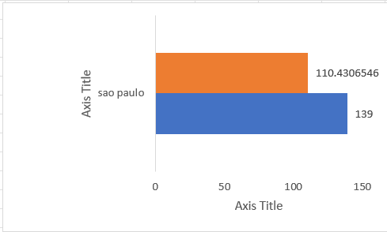
Average price and payment values from customers of sao paulo city ​
Comparison of Price vs Payment: The chart displays two key metrics—average price (139) and average payment value (110.43). The average payment value is notably lower than the average price, indicating that customers in São Paulo may be receiving discounts, using promotions, or that additional factors such as taxes, shipping, or payment methods are affecting the final payment amount.
Potential Revenue Gaps: The gap between the price and payment values suggests that while the listed or expected price is higher, the actual payment being made by the customers is less. This could be due to refunds, discounts, or the use of promotional codes, impacting the overall revenue from São Paulo customers
.Actionable Insight: This difference in average price and payment values review its pricing strategies, customer payment behavior, or promotional offers in São Paulo to ensure that it aligns with the revenue goals and customer satisfaction levels

Slide 15
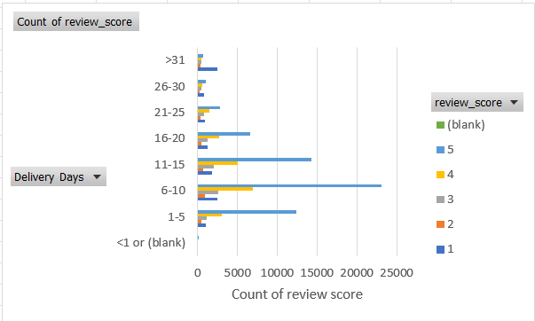
Relationship between shipping days Vs review scores ​
Delivery Time Impact on Review Scores: The chart reveals that shorter delivery times (1-5 and 6-10 days) tend to have a higher count of review scores, particularly in the higher score range (5 and 4 stars). This suggests that quicker deliveries generally lead to better customer satisfaction and higher review scores.
Critical Delivery Window: The 6-10 day range appears to be a critical window, where a significant portion of the reviews still skew toward higher scores, but longer delivery times (11-15 days) show a clear decline in customer satisfaction, evidenced by the shift toward more negative reviews (lower scores of 1 and 2).
Actionable Insight: faster deliveries correlate strongly with higher review scores.

Slide 16
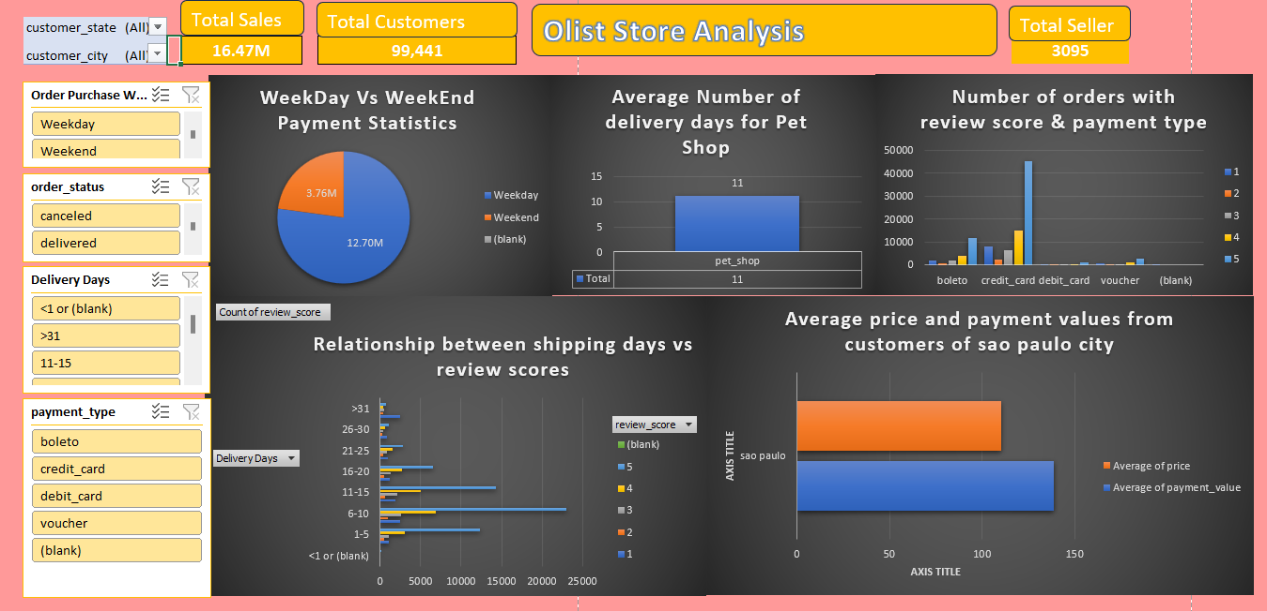
Dashboard : ​

Slide 17
Recommendations and Insights

Slide 18
Recommendations and Insights
Optimize Delivery Times for Better Reviews: Based on the relationship between shipping days and review scores, orders delivered within 1-10 days consistently receive higher review scores. Reducing delivery time could directly improve customer satisfaction and enhance overall ratings. Consider improving logistics efficiency to consistently meet this window.
Focus on Credit Card Payments for Better Reviews: The analysis of payment methods and review scores shows that customers using credit cards tend to give higher ratings (a large number of 5-star reviews). Promoting credit card usage through discounts or incentives might lead to better overall satisfaction.
Weekday Sales Dominate: The pie chart indicates that a substantial majority of payments occur on weekdays (12.70M compared to 3.76M on weekends). This insight suggests that marketing and promotional efforts should focus on weekday campaigns, possibly optimizing ads or discounts during this period to maximize sales.
Continued…

Slide 19
Recommendations and Insights
Review Scores Correlated with Faster Delivery: The delivery days chart shows that shorter delivery times (6-10 days) correlate with better review scores. This highlights the importance of delivery speed in customer satisfaction, suggesting that investing in faster delivery processes could improve brand reputation and drive repeat business.
Monitor Price vs Payment Discrepancies: In São Paulo, the average price of orders is higher (139) than the average payment value (110.43). This suggests possible discounts, refunds, or price mismatches that might impact revenue. The company should investigate and adjust promotional strategies or pricing models to optimize revenue without sacrificing customer satisfaction.
Voucher Payment Method Shows Fewer Transactions: The analysis of payment methods shows that the number of orders made using vouchers is significantly lower. This may indicate low engagement with voucher-based promotions, suggesting a review of the voucher campaign's effectiveness, or its broader appeal to customers, is needed.

Slide 20
Conclusions

Slide 21
Conclusions
Customer Satisfaction Through Delivery Optimization: Ensuring timely delivery remains a key driver of positive reviews and repeat business. Focusing on reducing delivery times to within 10 days can significantly enhance customer satisfaction and improve review scores.Leverage
Payment Insights for Growth: Credit card payments are associated with higher satisfaction levels, indicating that promoting this payment method could increase positive feedback. Additionally, addressing price-to-payment discrepancies can help streamline revenue and maintain customer trust.
Targeted Weekday Marketing: With the majority of transactions occurring on weekdays, prioritizing marketing efforts and promotions during this period will likely yield higher engagement and sales, helping the company capitalize on existing customer behavior patterns.

Slide 22
Thank you

